Slide 1
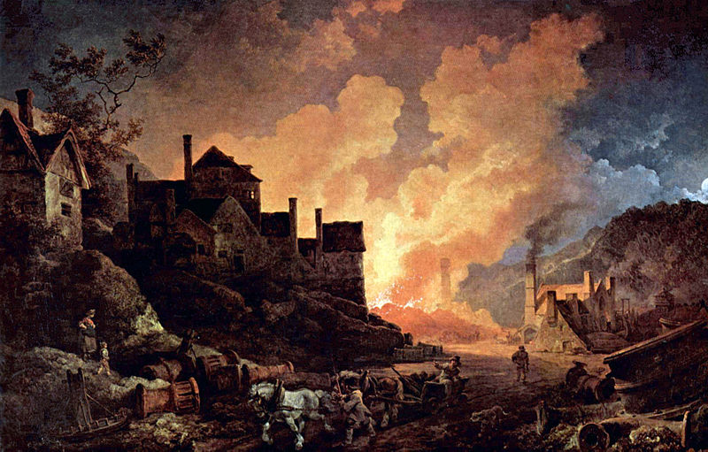
Chapter 22: The progress of industrialization
By Audrey Pham
Pictured above: Coalbrookdale By Night, painted by Philippe Jacques de Loutherbourg in 1801, depicts one of the Coalbrookdale ironworks. The development of coke smelting in this area revolutionized the production of iron and helped fuel the Industrial Revolution (“Image of Coalbrookdale”).

Slide 2
The technology to support machines
Industrialization required the efficient use of raw materials, beginning with cheap materials such as iron and coal.
England was at an advantage because it was well supplied with coal deposits that lay close to its iron core.
As coal mining required digging into deeper veins, the need for powerful pumps to remove water stimulated experiments to harness steam as a power source grew (Chambers 652).

Slide 3
Coal and iron
Coal was not useful in smelting iron because its impurities combined with the iron, making an inferior product.
Therefore, masters traditionally used charcoal, but it was expensive (Chambers 652).
In 1709, Abraham Darby invented a way of smelting iron with coke instead of charcoal (Mack).
As another replacement for charcoal, 18th century engineers experimented with coke (a purified form of coal) to produce pig iron, which could be cast but not worked or machined (Chambers 652).
Raw coke is grey, hard, and porous (“Coke (fuel)”).

Slide 4
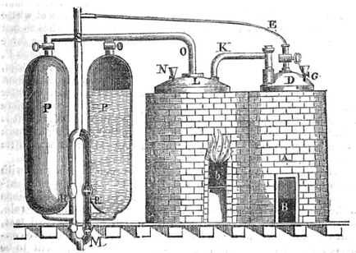
The atmospheric engine
In the 17th century, scientists proved that atmosphere has weight, leading to experiments that used atmospheric pressure to push a piston through a cylinder, in both England and on the Continent. Experiments developed the “atmospheric engine,” which required a partial vacuum, and before long, the condensation of steam was being used to create the partial vacuum required in the machine (Chambers 653).
The first commercially successful atmospheric engine was invented by Captain Thomas Savery. He presented his model to King William, and in June of 1699 obtained a patent that granted him exclusive privilege of manufacture. His invention was described in a book published in 1702, called The Miner’s Friend (Galloway 15).
Savery’s engine was, however, inefficient as a pump, drawing the attention of the blacksmith Thomas Newcomen for improvements. Along with his friend John Cawley, a glazier, Newcomen developed an atmospheric engine that had separate engine and pumps, and proved a third more efficient than Savery’s engine. They were about to apply for a patent when Savery claimed the invention as his, on the ground that the method of creating a vacuum through steam was his discovery; they were then forced to allow Savery’s name to be associated with the grant they obtained in 1705 (Galloway 19-20).
Newcomen’s engines were soon put to use removing water from mines not only in Great Britain, but in Austria, Denmark, France, and Hungary (Chambers 653).
A diagram of Thomas Savery’s original atmospheric engine plans (Galloway 15).

Slide 5
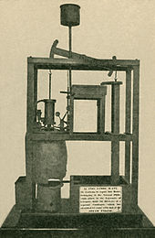
James watt and The Steam engine
James Watt, a young mechanic and instrument maker at the University of Glasgow, took the fundamental step in the development of steam.
In 1782, Watt’s first practical model of the steam engine was finally patented. With the addition of a system of gears for converting the piston’s reciprocating motion to rotary motion, it was three times more efficient than that of Newcomen.
Watt was able to make his machines a commercial success through his partnership with Matthew Boulton, who recognized the rising demand for cheap power (Chambers 653). Watt was also able to channel the vast resources of Boulton’s Soho Foundry.
The Boulton & Watt firm became so successful that it supplied engines and expertize as far as Greece and Russia (“Boulton”).
The model Newcomen engine that Watt experimented upon in developing his improved steam engine (Burns).

Slide 6
economic effects of revolution and war
Great Britain’s lead in production, invested capital, and the use of machinery increased steadily from 1789 to 1815. Great Britain’s lead in the Industrial Revolution was due in part to its larger population, and also to its abundance of resources (Beck 634).
On the Continent, the exploitation of resources became more systematic, population increased, transportation improved, the means of mobilizing capital for investment expanded, and political leaders became more interested in economic growth (Chambers 653-654).

Slide 7
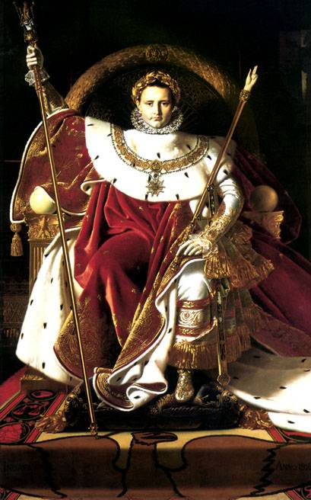
Effects of the French revolution and the Napoleonic era
The Napoleonic Code and French commercial law favored free contracts and open enterprise, and introduced the advantages of uniform commercial regulations.
When peace finally came after years of war, governments were burdened with debt and soldiers had to find ways to support themselves in a changed economy.
The Continental System fell with Napoleon, bringing down many enterprises with it.
Renewed British competition discouraged capital investment from other countries.
A transition to peacetime economy proved difficult to achieve when the anticipated demand for goods failed to materialize (Chambers 654).
Pictured above: Emperor Napoleon Bonaparte (“Napoleon”).

Slide 8
Patterns of industrialization
By the mid-1820s, Great Britain was reviving from its postwar slump; by 1830, its economy was being transformed.
Growth in one industry stimulated growth in another. Factories in one region encouraged the growth of others in the same region, and this concentration of production increased the demand for roads, canals, and railways. This required more capital, and the cycle repeated itself.
Great Britain’s industrial growth in the first half of the 19th century was the greatest humankind had ever experienced in terms of continuity, range of industries affected, national scope, and rate of increase.
Everywhere, but more often on the Continent than Britain, small-scale manufacturing existed alongside the new factories. However, the hand-powered looms, water-driven mills, and charcoal-fired smelters were gradually displaced, as were hundreds of thousands of skilled artisans and rural families that worked in their homes. This transformation and resulting displacement accounted for much of the human suffering caused by industrialization (Chambers 654-655).

Slide 9
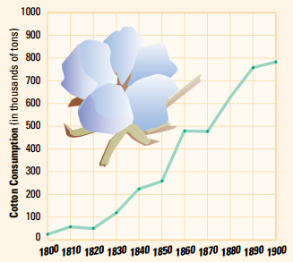
Cotton
Due to consumer demand, cotton became the single most important industrial product in Great Britain in terms of output, capital investment, and workforce.
Cotton production was organized mainly in factories that used power-driven machinery for spinning yarn and weaving cloth, such as Edmund Cartwright’s power loom (Mack).
Following the increased production of cotton, prices dropped to about one-twentieth of what it was in the 1760s (Chambers 654).
The consumption of cotton increased dramatically in the 19th century, as pictured above. This stimulated the growth of the cotton industry , and as a result, other industries (Beck 636).

Slide 10
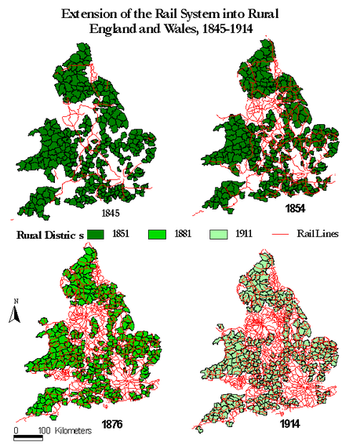
Railroads and the telegraph
The first successful steam railway line was built in England in 1825; by 1851, there were 7,000 miles of rail lines in Great Britain.
Railroads made up a new industry that further stimulated industrialization: they bought coal and iron for rails, carried food, manufactured products, raw materials, and building materials to different areas. They also provided transportation for those searching for work (Chambers 655).
Business tended to spring up beside the railways because of the constant traffic. Prices for the carriage of goods decreased, and delivery became more frequent and less dependent on the weather (Dowd).
The telegraph was developed by a generation of scientists in different countries. It was eventually adopted as an adjunct of railroading and expanded to other uses as well (Chambers 655).
The above image shows the growth of railway lines in England between 1845 and 1914 (Schwartz).

Slide 11
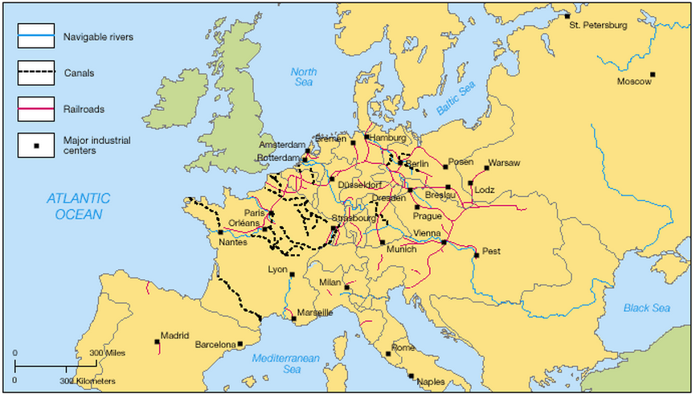
Transportation on the continent, 1850
“Major developments in transportation took place in Germany and along the English Channel, where there better natural resources or pools of labor” (Burnett).

Slide 12
National differences
By the 1850s, the zone of industrialization included only Great Britain, northeastern France, Belgium, the Netherlands, western Germany, and northern Italy.
Belgium built on its tradition of technological skill, geographic advantages, and access to coal to become the Continent’s first industrialized nation. It extracted more coal than Germany or France and was the first nation to complete a railway network.
Eastern Europe remained a world of mostly agricultural estates.
Increased production led to closer international ties as capital, techniques, workers, and managers moved from Britain to Belgium and France, and spread into the rest of Europe (Chambers 655).

Slide 13
State politics
The state was centrally involved in economic growth by mid-century, even in Britain. In the case of the railway, things like routes, rates, and the gauge of the track became issues to be settled by parliaments or special committees (Chambers 656).
Tariffs became a dominant issue in every country. In 1846, the Anti-Corn-Law-League, formed in Manchester, won a significant victory in abolishing the Corn Law, which imposed a tariff on imported corn when prices fell too low, thereby protecting the English landholders (Cody).
Banking and currency were also important to economic development. Mid-century, Parliament granted the Bank of England a monopoly and required companies to register with the governments and publish their annual budget as a guide to investors. Similar measures were taken throughout Europe (Chambers 656).

Slide 14
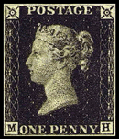
The role of government
The growth of cities and better technology led to additional social demands on government. By the 1840s, most cities had some sidewalks, gas lighting in certain areas, and a public omnibus. These services had to subsidized, regulated, and given legal protection by the government (Chabers 656).
The postal service is an example of government involvement. In the industrial age, the current postal system could not keep up. Reforms suggested by a man named Rowland Hill were adapted in Great Britain (“The Invention”). Among his reforms were standard envelopes and payment in advance in the form of a small adhesive stamp. Within twenty years, the volume of mail in Britain had increased sixfold. By the 1850s, every major government had adopted Hill’s new system.
The government was now expected to provide economic growth (Chambers 656).
The Penny Black stamp, pictured above, was the first stamp to be put into use (“Penny”).

Slide 15
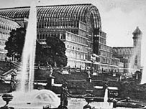
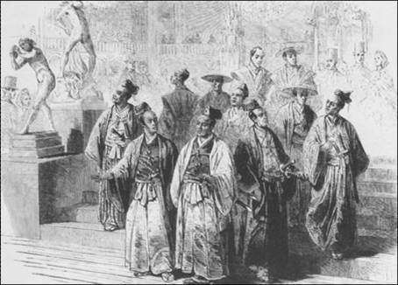
The crystal palace
The Crystal Palace was an architectural milestone: a huge glass and iron structure built in London’s Hyde Park for the purpose of housing the first international industrial exhibition in 1851.
By 1850, Great Britain was the wealthiest nation in history. Prince Albert, head of the Society of Arts, suggested an exhibition to show off Britain’s industrial prowess to the rest of the world.
Countries included France, the United States, Russia, Turkey, Egypt, Germany, the Italian states, and Austria.
Exhibits fell into four major categories: raw materials, machinery, manufacturers, and fine arts.
Many governments feared Britain risked the start of a revolution by drawing such crowds to London, but the 2 million visitors a year proved to be well-behaved (“The Crystal Palace”).
Above: The Crystal Palace (“The Crystal Palace”).
Below: The Japanes delegation visiting the Crystal Palace (“Crystal Palace”).

Slide 16
Works cited
Beck, Roger, and Linda Black. McDougal Littell World History: Patterns of Interaction. N.p.: Steck-Vaughn, 2004. Print.
"Boulton & Watt Engine." Nms.ac.uk. National Museums Scotland, n.d. Web. 19 Dec. 2012.
Burnett. "AP World History - Maps." AP World History - Maps. N.p., n.d. Web. 19 Dec. 2012.
Burns, Elmer E. The Story of Great Inventions. N.p.: Harper & Brothers, 1910. Print.
Chambers, Mortimer, Barbara Hanawalt, Theodore Rabb, Isser Woloch, Raymond Grew, and Lisa Tiersten. The Western Experience. 9th ed. Boston: McGraw-Hill, 2007. Print.
Cody, David. "Corn Laws." Victorian Web. N.p., 1987. Web. 19 Dec. 2012.
"Coke (fuel)." Wikipedia. Wikimedia Foundation, 6 Dec. 2012. Web. 18 Dec. 2012.
"Crystal Palace." Art History & Archaeology. University of Maryland, n.d. Web. 19 Dec. 2012.
“The Crystal Palace." BBC News. British Broadcasting Company, Apr. 2008. Web. 19 Dec. 2012.
Dowd, Steven. "The Liverpool & Manchester Railway." Journal of the International Bond & Share Society (1997): n. pag. N-le-w.co.uk. International Bond & Share Society. Web. 19 Dec. 2012.
Galloway, Elijah. History of the Steam Engine: From Its First Invention to the Present Time. N.p.: Cowie and, 1826. Google Books. Google. Web. 18 Dec. 2012.
Image of Coalbrookdale by Night, 1801. by Science & Society Picture Library. Digital image. Science & Society Picture Library. Science Museum, n.d. Web. 19 Dec. 2012.
Mack, Pamela E. "British Industrial Revolution." Clemson.edu. Clemson University, 26 Sept. 2005. Web. 19 Dec. 2012.
"Napoleon." Clas.ufl.edu. University of Florida, n.d. Web. 19 Dec. 2012.
"Penny Black Stamps." Pennyblackstamp.co.uk. Penny Black Stamps, 2008. Web. 19 Dec. 2012.
Schwartz, Robert M. "Railways and Population Change in Industrializing England, 1851-1914." Railways and Population Change in Industrializing England, 1851-1914. Mount Holyoke College, 24 Apr. 1999. Web. 19 Dec. 2012.

